Slide 1
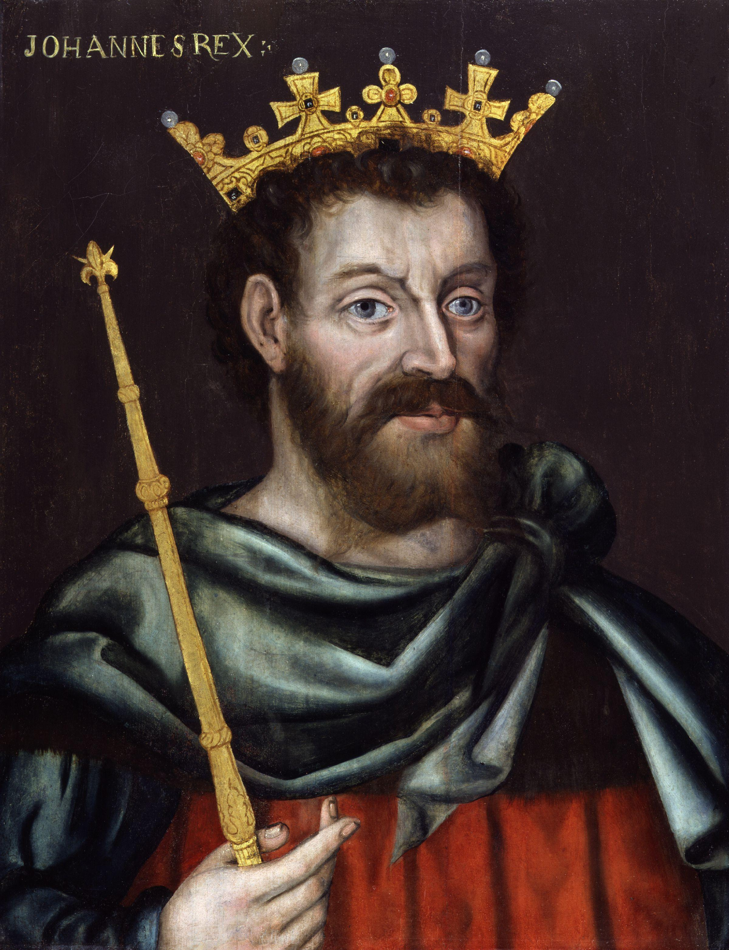
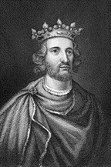
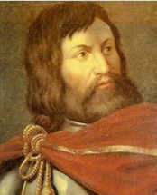
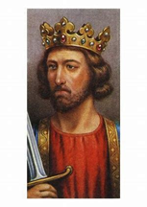
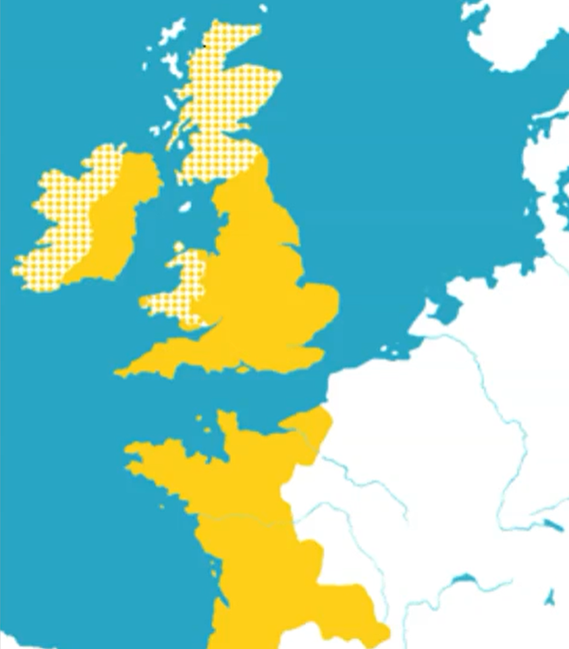



Why was 1066 a significant year?
Key factors
Wars – A Medieval king was expected to protect his people from invasion and to be a good fighter/warrior. If he won battles then the plunder and land gained could be shared with his barons. King John lost many battles losing control of much of the Angevin empire. By contrast Edward won battles against the Welsh and Scottish.
Barons – A Medieval king needed to have a good working relationship with his barons. John frequently fell out with his barons as they complained about taxes like Scutage and forced him to sign Magna Carta. When he went against Magna Carta they went to war with John (First Barons War) and with the help of the King of France forced John to retreat. Henry III faced the Second Barons War and was arrested and defeated by Simon DeMontfort after the Battle of Lewes. However, Henry’s son Edward I led an army that defeated Simon Demontfort at the Battle of Evesham.
Religion – A Medieval king needed to show respect and support for the Catholic church. King John was excommunicated after a disagreement with the pope about who should be the next Archbishop. King Henry III was threatened with the same punishment after failing to keep a promise he made to the Pope. Henry III did however, spend a lot of money rebuilding Westminster Abbey. Edward I showed his loyalty to the church by leading a crusade shortly before he was crowned king.
Key terms
Church = The whole Catholic religion.
church = A single building.
Rebel = To oppose (Go against) the leader (King).
Scutage = A tax Barons paid to avoid fighting in a war.
Statute = A written law.
Excommunicate = Exclude from the services of the Catholic church (People at the time believed this would stop them getting to heaven).
Crusades = Religious wars.
Magna Carta = A charter (Written document) giving rights.
Homage = To publically pay respect to your Lord and Feudal allegiance.
Provisions of Oxford = An agreement made between rebel barons (Including Simon DeMontfort) and King Henry III that meant the king had to listen to a council of fifteen.
Parliament = A new idea created by Simon DeMontfort in which 2 Knights from the shires, 2 townsmen, Barons, Bishops the Prince of Wales and King of Scotland met with the King of England to create statutes and taxes.
Key people
King John
(Younger brother to Richard I) Nickname ‘Softsword’
King Henry III (Son of John)
Rebuilt Westminster Abbey
Simon DeMontfort
(Rebel Baron and creator of parliament)
Edward I (Son of Henry III) Nicknames ‘Longshanks’ and ‘Hammer of the Scots’
Angevin Empire at the beginning of King John’s reign
Timeline of Key Events
1199 1209 1215 1216 1258 1264-67 1265 1272
King John He is Excommunicated Magna Carta King Henry III Provisions of Second Barons First King Edward is crowned & First Barons War is crowned Oxford War Parliament is crowned

