Slide 1
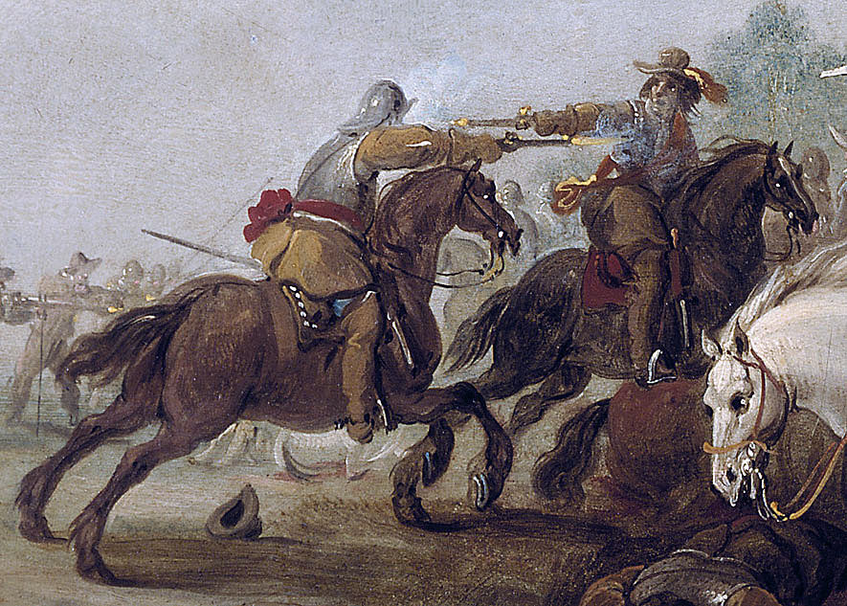







What happened during the Civil War? Knowledge Organiser
Key questions
Should it be called the English or British Civil Wars?
Who won the wars and why?
What was life like for civilians?
Key people
Charles I King of England between 1625 and 1649
Henrietta Maria Catholic wife of Charles I
Prince Rupert Leader of the Royalist forces and nephew of King Charles
Judge John Bradshaw Judge in the trial of King Charles I
Oliver Cromwell Leader of cavalry in New Model Army and Lord Protector between 1653 and 1658
Henry Ireton Leader of the Parliamentarian forces
Lady Derby Royalist who defended her home against a force of Parliamentarian troops.
Key terms
Civilian = Somebody not involved in the fighting (Not a soldier)
Royalist = A supporter of the King
Cavalier = Nickname given to supporters of the King
Parliamentarian = A supporter of Parliament
Roundhead = Nickname given to supporters of Parliament
New Model Army = An army created during the Civil War with strong discipline
Purge = To remove something (In the case of Pride’s purge any MPs who liked King Charles were removed)
Treason = the crime of betraying your own country
Execution = To kill somebody who has been sentenced to death
Regicide = The action of killing a king
Trial = A ceremony to decide if someone accused of a crime is guilty or innocent
MP = Member of Parliament
Skirmish = A small unplanned fight
Siege = An event where enemy forces surround a building or town, hoping to trap the people in the building/town
Yield = To surrender under pressure
Cavalry = Soldier on horseback
Infantry = Soldier on foot
TIMELINE OF KEY EVENTS
Date | Event
October 1642 | Battle of Edgehill- neither side wins
July 1644 | Battle of Marston Moor- Parliament wins
Feb 1645 | Creation of the New Model Army
June 1645 | Parliament wins a decisive victory at the Battle of Naseby
May 1646 | Charles surrenders to the Scots
Nov 1647 | Charles escapes from prison and starts the second Civil War
Nov 1648 | Pride purges Parliament after Charles has been recaptured
Jan 1649 | Charles is found guilty of treason and executed

