Slide 1
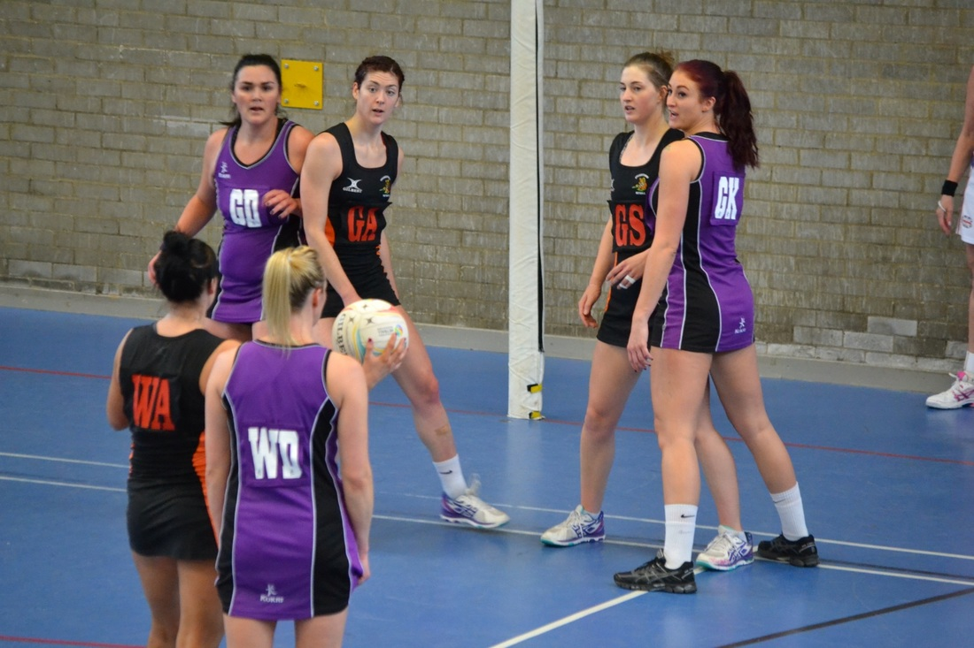
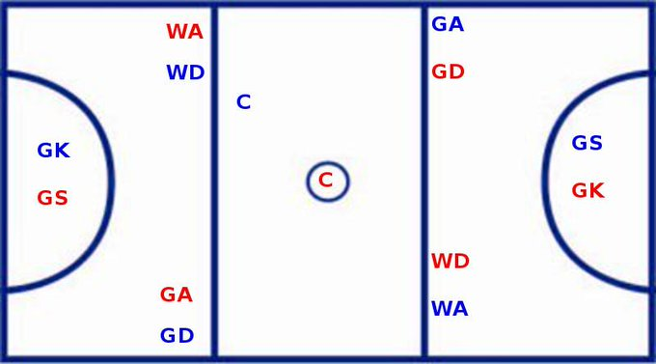
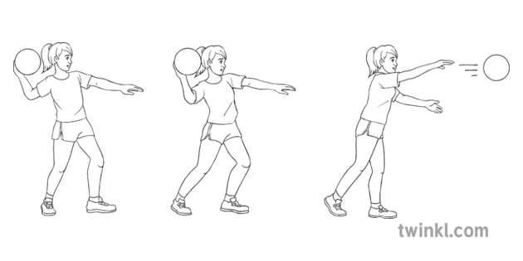
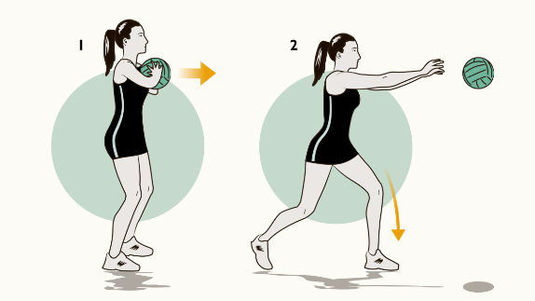
KS2 Netball
Defending in Netball
Even if you are playing in an attacking position you still have to defend any time your team is not in possession of the ball. At the start of a game, make sure you know which player you are responsible for marking. Tips for defending: Be netball ready! On your toes, knees slightly bent ready to catch or intercept the ball. Keep close to our opponent Make sure you are always ball side Mark in a sideways stance so you can see the player and the ball Keep close to you opponent!
Keyword | Definition
Space | An area that is free and where there is nobody else.
Interception * | Catching a pass made by a player on the opposite team.
Defending | Guarding a player to stop or reduce the chance of the other team scoring
Attacking | Creating space to create scoring opportunities
Passing and Receiving the Ball
Shoulder Pass Opposite foot to throwing hand Bring ball back to shoulder Fingers spread Transfer weight as you bring the throwing arm through Always the ball to the space in front of the player you are sending it to. | Chest Pass Stand front on with the ball in two hands at chest height with elbows down (chicken wings) Spread fingers around ball (W shape) Step forward and transfer weight as you release the ball Flick your wrists and fingers as you release the ball
Attacking in Netball
When attacking in Netball we need to create space to be successful. We create space by: Changing speed Changing direction Driving (sprint) into the space
Positions
Year 5 You should know what most of the positions are and where one of two of them are allowed to play in game. Year 6 You should know all of the positions and where most of them are allowed to play in a game
 | Netball position
GK | Goal Keeper
GD | Goal Defence
WD | Wing Defence
C | Centre
WA | Wing Attack
GA | Goal Attack
GS | Goal Shooter
Rules
You cannot travel with the ball You cannot snatch or hit the ball out of a players hands (contact) You must stay 3ft away from the person with the ball. You cannot hold you ball for more than 3 seconds.

Slide 2
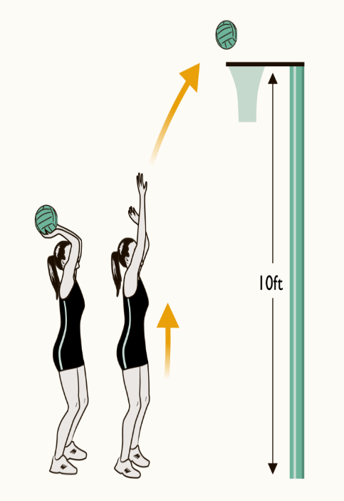

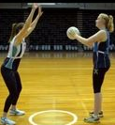
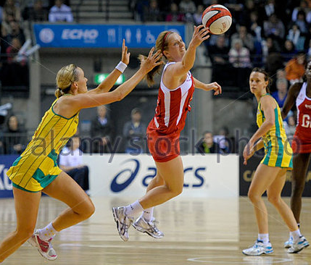
Shooting
Prepare Feet shoulder width apart Ball held by dominant hand and high above the head. Fingers point back and are slightly open, ball sits in your hand. Second hand is placed at the side of the ball to steady its position Elbows slightly flexed, lined in the direction of the post. Squat Bend knees Maintain balanced position Flex elbows not allowing the ball to drop behind your head Shoot Power through the ankles by pushing up through slightly flexed knees Wrist flicks as the ball is released off the fingers in order to create a backwards spin Aim to drop the ball through the net without it touching the ring.
KS3 Netball
Defending in Netball
Stage 1 – Mark the player! They haven’t got the ball yet but can you can still man mark them.
Stage 2 – Mark the ball – when the player has the ball make it difficult for them to make their next pass.
Stage 3 – Marking the space. Anticipate the pass and prepare to drive in front to snatch it away.
“Choose and use” Make decisions about when to pass, keep or move with the ball in competitive situations.
When you receive the ball to should look to see the best option of where to pass to. Listen to players who are calling for the ball – are they still free? Pass the ball to a team mate who driving in a space and is away from their marking player. Always pass the ball in in the space in front of the player.
Creating Space in Netball
Change Speed If you keep running at the same pace throughout a netball match you will become very tired or find it difficult to get away from defending players. Choose wisely when you should offer an option. When you see a space, call for the ball, signal and drive (sprint) into that space. Change direction and Dodging Changing direction and dodging are good tactics to help us to outwit our opponents to get free and create space.
Keyword | Definition
Opponent | The opponent is your competition e.g. a player you are marking or trying to outwit
Interception | Catching a pass made by a player on the opposite team.
Tactic | An action or strategy carefully planned to achieve a specific end

