Slide 1
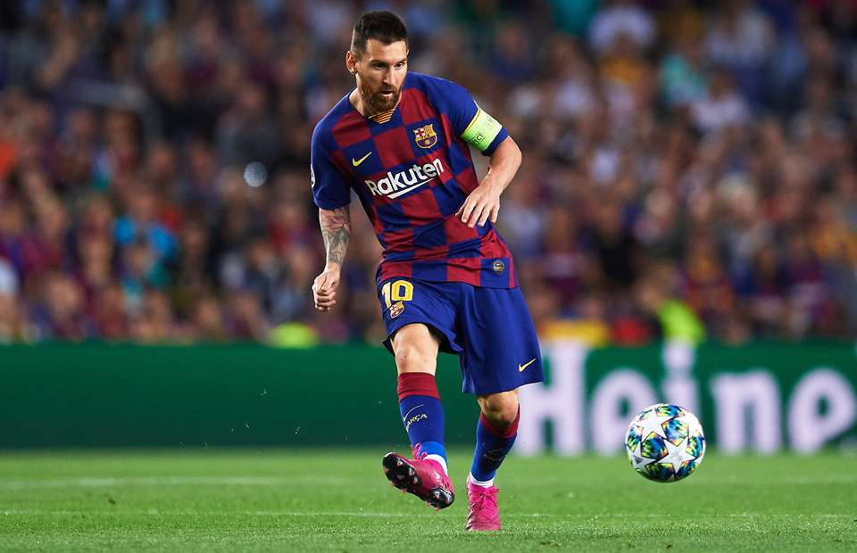
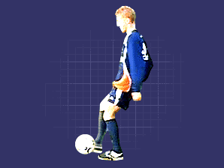
KS2 Football
Controlling the ball
Get into line with the flight of the ball as quickly as you can and decide how you are going to control the ball. Present the area of your body that you want to control the ball with - your foot for example. Get as large an area behind the ball as you can. If you are controlling the ball with your foot then get the full face of it in line with the ball. As you make contact with the ball, relax the surface area so that you can cushion the ball.
Short passing
The side foot (inside of the foot) provides the greatest accuracy for passing. Ideally, you want to approach the ball at an angle of about 30 degrees so that you have room to swing your kicking leg through. Get your non-kicking foot close to the side of the ball, use your arms for balance and keep your head still and eyes on the ball. Keeping your ankle firm, bring your kicking foot through and strike the centre of the ball (to keep it on the ground) with the side of the foot. With this type of passing you are looking to keep the ball low so that it is easy for a team-mate to control. The weight you put on the pass is also critical. Follow through with the kicking leg to increase power, but the weight of the pass will depend on how far away your team-mate and opposition players are.
Dribbling
Keep the ball close to your feet Practise with the inside, outside of the foot and with rolling the foot over the ball, using the sole. Use both the left and right foot Shift your body weight to throw the defender off balance, use fakes to create space for yourself. Tricks and skills can add great variety to your dribbling and be effective in tight spaces.
Football Facts
11 players per side. Matches are 90 minutes in length. The aim is to kick or head the ball into the oppositions goal. Goalkeepers are the only players allowed to handle the ball. The referee keeps the players under control. They use red and yellow cards to punish fouls or bad behaviour.
Attacking in Games activities
When attacking in Games activities we need to create space to be successful. We create space by: Changing speed Changing direction Driving (sprint) into the space
Keyword | Definition
Space | An area that is free and where there is nobody else.
Interception * | Catching a pass made by a player on the opposite team.
Defending | Guarding a player to stop or reduce the chance of the other team scoring
Attacking | Creating space to create scoring opportunities

Slide 2
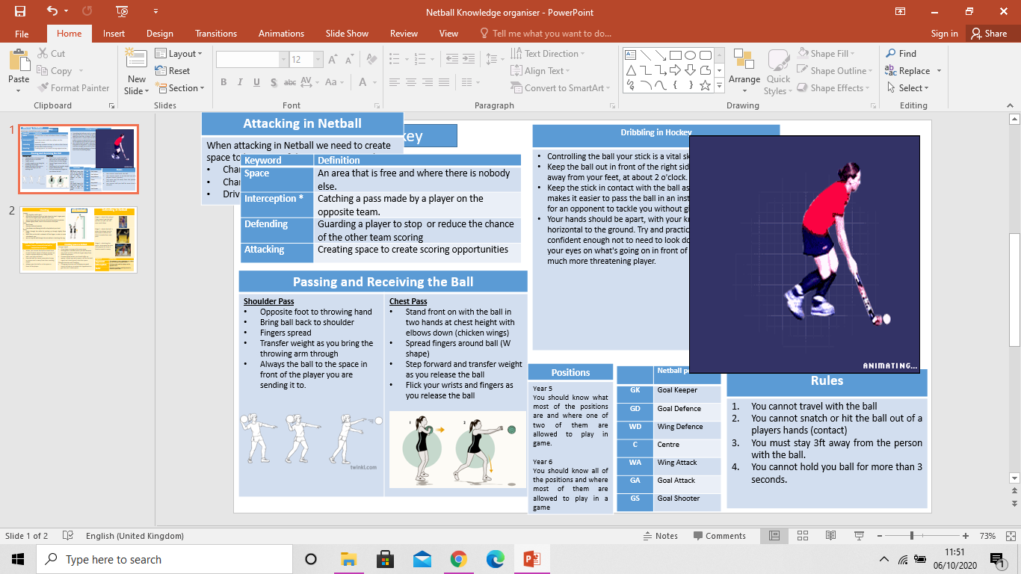
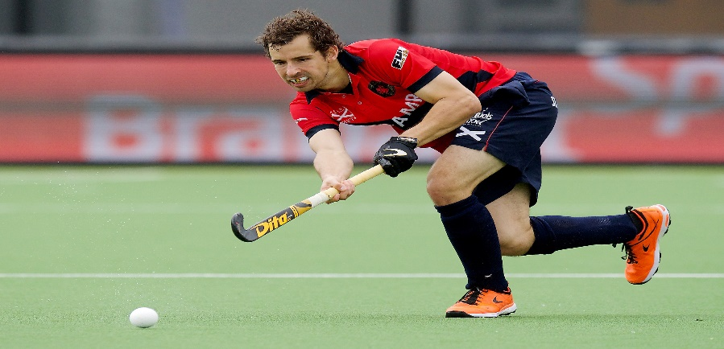
KS2 Hockey
Basic Dribbling in Hockey
Controlling the ball with your stick is a vital skill to learn in Hockey. Here are some tips on dribbling the ball. Keep the ball out in front of the right side of your body and away from your feet, at about 2 o'clock. Keep the stick in contact with the ball as much as possible Your hands should be apart, with your knees bent and your back horizontal to the ground. Try and practice dribbling so you are confident enough not to need to look down at the ball - keeping your eyes on what's going on in front of you will make you a much more threatening player.
Keyword | Definition
Space | An area that is free and where there is nobody else.
Interception * | Catching a pass made by a player on the opposite team.
Defending | Guarding a player to stop or reduce the chance of the other team scoring
Attacking | Creating space to create scoring opportunities
Passing the ball – A push pass
Your hands should be approximately 30cm apart with the left hand near the top of the stick and the right hand further down. Keep your eyes on the ball, with your feet apart and knees bent. Follow through keeping your stick in contact with the ball for as long as possible, increasing the speed of your stick head as you near your front foot. To gain more power and pace, make sure you are nice and low and side on to the target and follow through strongly with your stick - it should finish pointing towards the direction of the pass.
Receiving the Ball - Get low, get low & get low!
Get your stick down early, keeping it low to the ground with a nice firm but relaxed grip. Bend from the knees, not just the waist. Your hands should be approximately 30cms apart. The left hand should be near the top of the stick and the right hand further down It should feel as though you are allowing your stick to "give" a little on contact. Keeping your hands relaxed at the point of contact will help. This is sometimes called "soft" hands.
Basic Hockey Rules
You can only he ball with the flat side of the stick Hockey players (other than the goalkeeper) are not allowed to use their feet, or any other parts of the body, to control the ball at any time. If the hockey ball is hit from outside the circle and goes into the goal, it does not count as a goal. Hockey is a non-contact sport. Hockey players may not trip, push, charge, interfere with, or physically handle an opponent in any way.
Attacking in Games activities
When attacking in Games activities we need to create space to be successful. We create space by: Changing speed Changing direction Driving (sprint) into the space

Slide 3
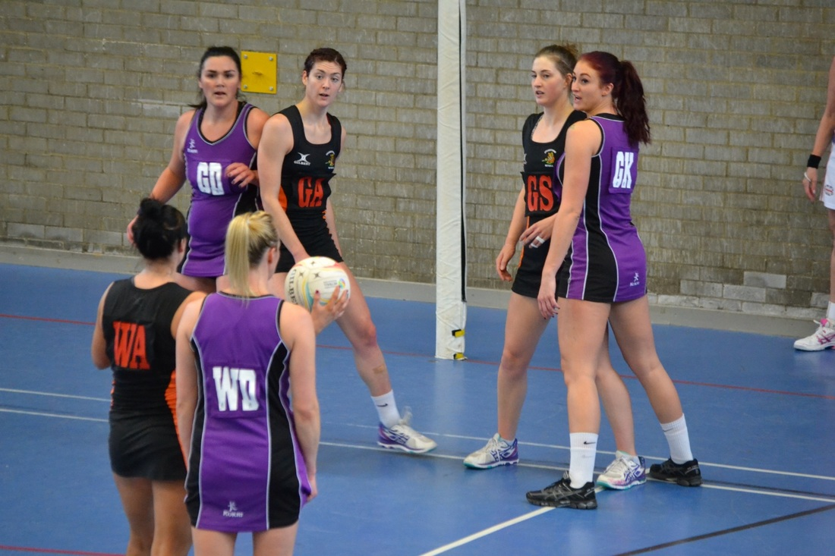
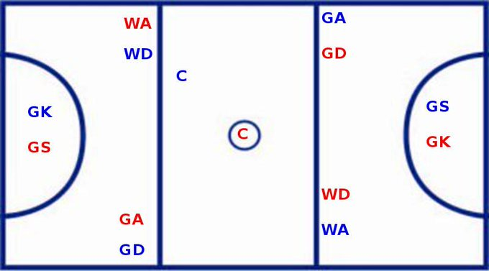
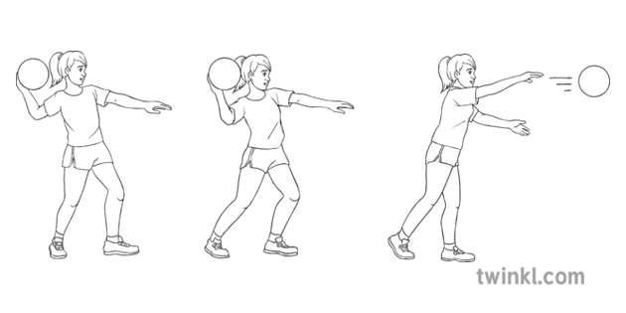
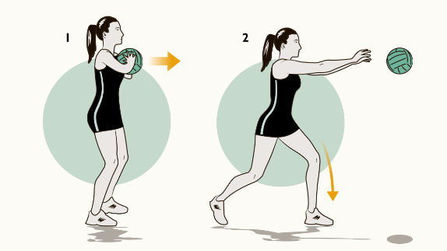
KS2 Netball
Defending in Netball
Even if you are playing in an attacking position you still have to defend any time your team is not in possession of the ball. At the start of a game, make sure you know which player you are responsible for marking. Tips for defending: Be netball ready! On your toes, knees slightly bent ready to catch or intercept the ball. Keep close to our opponent Make sure you are always ball side Mark in a sideways stance so you can see the player and the ball Keep close to you opponent!
Keyword | Definition
Space | An area that is free and where there is nobody else.
Interception * | Catching a pass made by a player on the opposite team.
Defending | Guarding a player to stop or reduce the chance of the other team scoring
Attacking | Creating space to create scoring opportunities
Passing and Receiving the Ball
Shoulder Pass Opposite foot to throwing hand Bring ball back to shoulder Fingers spread Transfer weight as you bring the throwing arm through Always the ball to the space in front of the player you are sending it to. | Chest Pass Stand front on with the ball in two hands at chest height with elbows down (chicken wings) Spread fingers around ball (W shape) Step forward and transfer weight as you release the ball Flick your wrists and fingers as you release the ball
Attacking in Netball
When attacking in Netball we need to create space to be successful. We create space by: Changing speed Changing direction Driving (sprint) into the space
Positions
Year 5 You should know what most of the positions are and where one of two of them are allowed to play in game. Year 6 You should know all of the positions and where most of them are allowed to play in a game
 | Netball position
GK | Goal Keeper
GD | Goal Defence
WD | Wing Defence
C | Centre
WA | Wing Attack
GA | Goal Attack
GS | Goal Shooter
Rules
You cannot travel with the ball You cannot snatch or hit the ball out of a players hands (contact) You must stay 3ft away from the person with the ball. You cannot hold you ball for more than 3 seconds.

